Slide 1
Oil and Natural Gas Sector
New Source Performance Standards
Small Entity Representative Pre-Panel Outreach
June 2021

Slide 2
Overview
Background
Consultation with Small Entity Representatives
Clean Air Act Section 111 – Emissions Standards
Regulatory History
Executive Order on Protecting Public Health and the Environment
Sector Overview
Methane Emissions in the Oil and Natural Gas Sector
Small Business Size Definitions
Scope of the 2021 Proposal
Current Applicability and Requirements
Potential Control Strategies
Cost Estimates (2019$)
Other Federal Regulations
Schedule
Input Requested
Contact information

Slide 3
Consultation with Small Entity Representatives
EPA is interested not only in information, but also in advice and recommendations from the small entity representations (SERs)
EPA will use this information to develop a regulatory flexibility analysis, which becomes part of the record for the potential regulation
Key elements in this analysis:
Number of small entities to which the potential rule would apply
Projected compliance requirements of the potential rule
Identification of all relevant federal rules that may duplicate, overlap or conflict with the potential rule
Any significant alternatives to the potential rule that accomplish the stated objectives and that minimize significant economic impact of the potential rule on small entities

Slide 4
SERs and the Regulatory Process
We are seeking information on how the options presented might affect your business or organization
Provide specific examples of impacts
Provide cost data, if available
We are also seeking input on regulatory alternatives that still accomplish the objectives of the Clean Air Act
Suggest other relevant control strategies, including data on their costs, effectiveness, and information on how to ensure compliance
The Regulatory Flexibility Act (RFA) suggests flexibilities, such as exemptions, different compliance timetables, and simplified reporting requirements
We would like to minimize duplication
Provide information on any potentially duplicative or contradictory federal, state, or local regulations.

Slide 5
Clean Air Act Section 111 – Emissions Standards
For source categories that cause or contribute significantly to air pollution which may reasonably be anticipated to endanger public health or welfare, Section 111 of the Clean Air Act requires that EPA establish standards of performance for new sources and, for certain pollutants, issue regulations under which states establish standards of performance for existing sources.
Standards must be set based on what is achievable through the application of the best system of emission reduction (BSER)
To determine BSER, EPA must consider:
Cost (must not be “exorbitant,” “greater than the industry can bear,” or “unreasonable”)
Non-air quality health and environmental impacts
Energy requirements
Technology that has been adequately demonstrated
When issuing regulations for existing sources, EPA allows states to take into account the remaining useful life of those sources, and other factors, in applying standards of performance in their state plans

Slide 6
Regulatory History
2012 – NSPS OOOO regulated VOC emissions from several sources in the production and processing segments
2016 – NSPS OOOOa added methane as a regulated pollutant and expanded regulations through the transmission and storage segment. NSPS OOOOa also added requirements to cover additional sources; included fugitive emissions monitoring
2020 Policy Rule – removed the transmission and storage segment from OOOO and OOOOa and rescinded methane standards in the production and processing segments
2020 Technical Rule – exempted low production well sites from fugitive emissions monitoring, decreased monitoring frequency at compressor stations to semi-annually, allowed compliance with state requirements as an alternative to fugitive emissions requirements

Slide 7
Executive Order on Public Health and the Environment
On January 20, 2021, President Biden issued Executive Order 13990, Protecting Public Health and the Environment and Restoring Science to Tackle the Climate Crisis
Among other direction to EPA, the order instructs EPA to consider taking two actions by September 2021 focused on reducing methane emissions from the oil and gas sector:​
Propose strengthening previously issued standards for new sources
Propose emission guidelines for existing operations in the oil and gas sector
These actions both fall under section 111 of the Clean Air Act

Slide 8
Oil and Gas Sector Overview
The NSPS has generally characterized industry operations as being composed of four segments :
Production of Oil and Natural Gas
Natural Gas Processing
Natural Gas Transmission
Natural Gas Storage
In the U.S. there are over 15,000 oil and gas owners and operators and the large majority are small entities
Around one million producing onshore oil and gas wells
About 5,000 gathering and boosting facilities
Over 650 processing facilities
About 1,400 transmission compression facilities
Over 900 transmission pipeline facilities
Over 400 underground natural gas storage facilities
Over 100 liquefied natural gas storage or import/export facilities

Slide 9
Oil and Gas Sector Overview
Natural Gas Production & Processing
Oil Production
Storage tanks
Well completions
Pneumatic controllers
Processing plant leaks
Compressors
Equipment leaks
Pneumatic pumps
Storage tanks
Pneumatic controllers
Well completions
Equipment leaks
Pneumatic pumps
Crude oil sent to petroleum refinery
(not covered by Oil and Gas NSPS)
Natural Gas Transmission and Storage
Storage tanks
Compressors
Equipment leaks
Pneumatic controllers
Natural Gas Distribution
Has never been covered under the NSPS
Source: Adapted from American Gas Association and EPA Natural Gas STAR Program

Slide 10
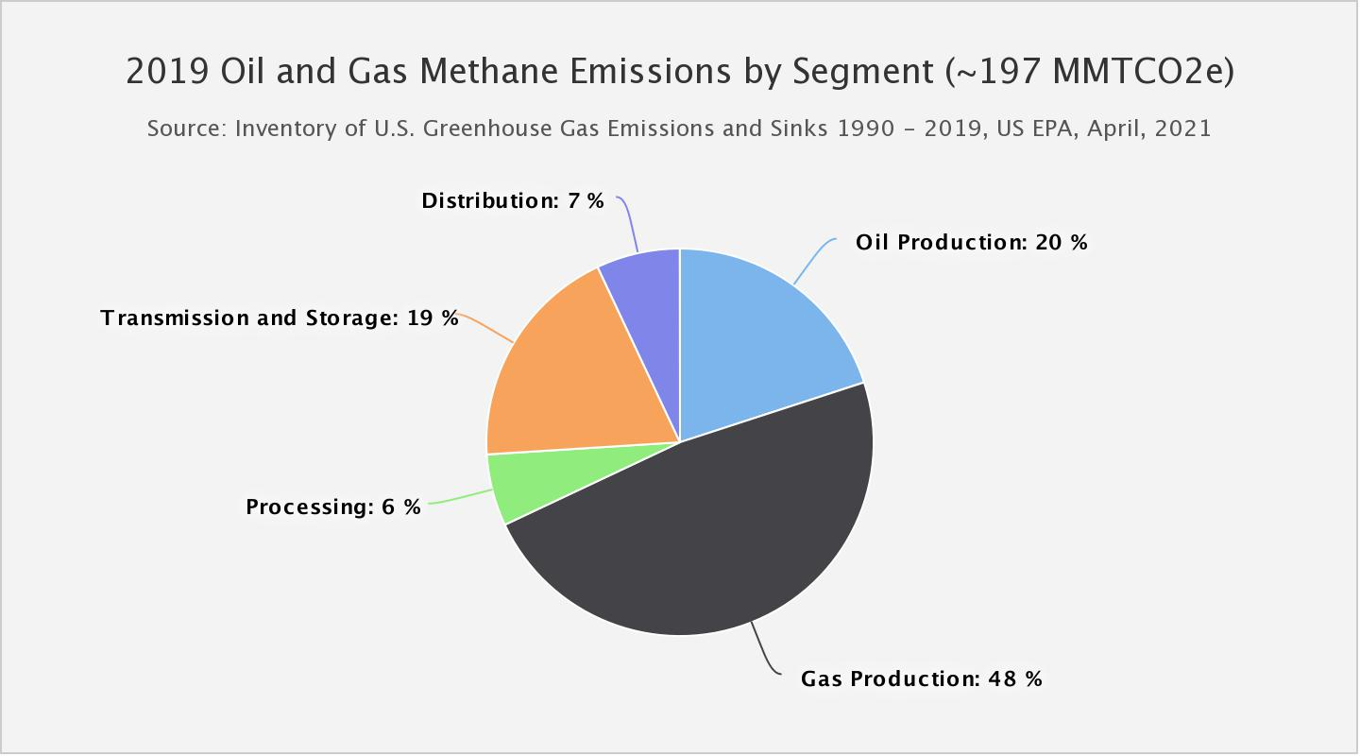
Methane Emissions: Oil and Natural Gas Sector

Slide 11
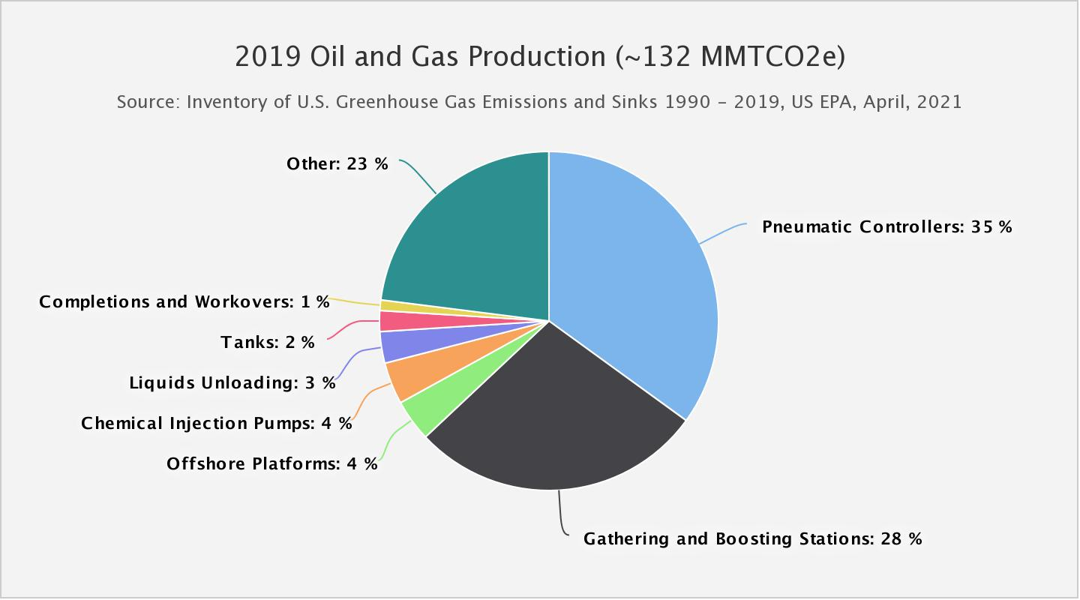
Methane Emissions: Oil and Natural Gas Production

Slide 12
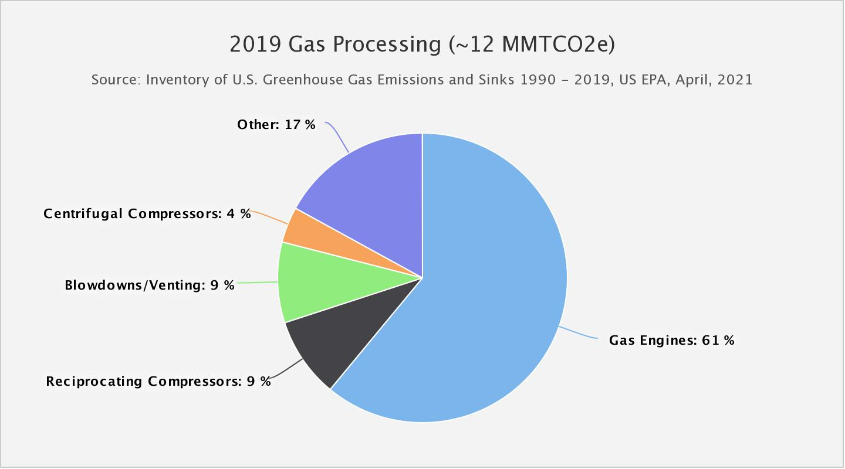
Methane Emissions: Natural Gas Processing

Slide 13
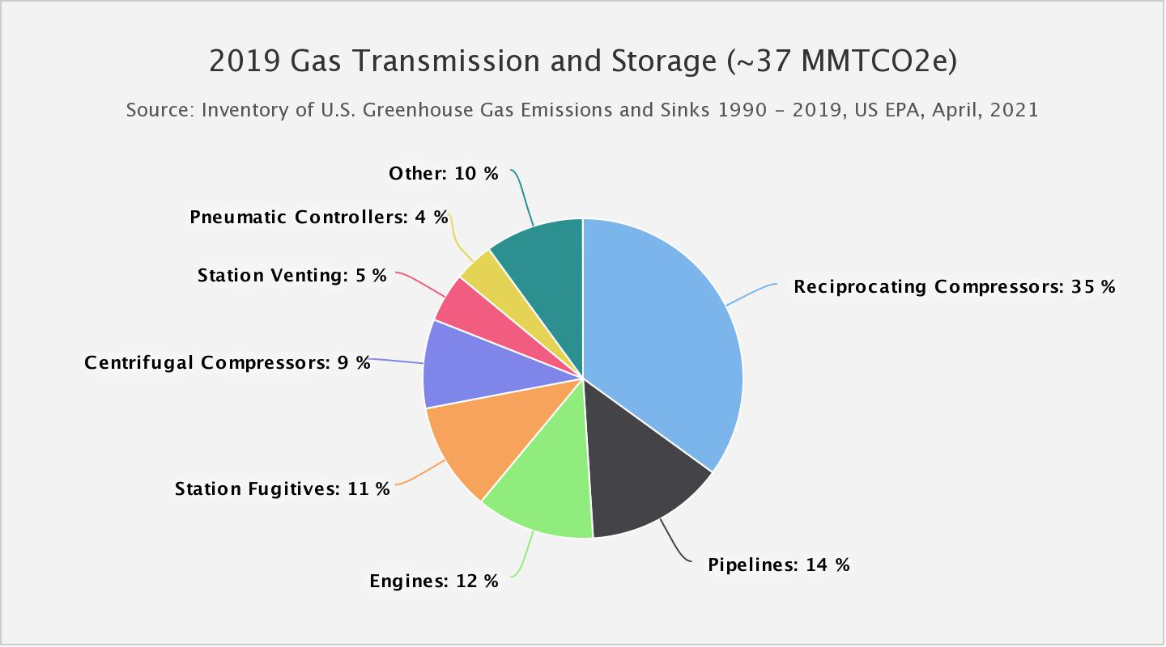
Methane Emissions: Transmission and Distribution

Slide 14
Industry Sectors and Their Small Business Size Definitions
Industry sectors included in the source category as defined by North American Industry Classification System (NAICS)
NAICS | Description | Size Standard
211120 | Crude Petroleum Extraction | 1,250 employees
211130 | Natural Gas Extraction | 1,250 employees
213111 | Drilling Oil and Gas Wells | 1,000 employees
213112 | Support Activities for Oil and Gas Operations | $41.5M in annual revenues
486210 | Pipeline Transportation of Natural Gas | $30.0M in annual revenues
Note: The list of NAICS is not exhaustive

Slide 15
Estimated Number of Facilities
Work is ongoing to determine affected facility counts for the NSPS
The following table illustrates small business concentrations in the broader oil and natural gas industry
NAICS | Description | Total firms | Small business percentage
211120 | Crude Petroleum Extraction | 4,461 | 98.8 – 99.0%
211130 | Natural Gas Extraction | 617 | 92.9 – 93.7%
213111 | Drilling Oil and Gas Wells | 1,725 | 98.1%
213112 | Support Activities for Oil and Gas Operations | 8,487 | 96.7 – 97.1%
486210 | Pipeline Transportation of Natural Gas | 128 | 31.3 – 39.8%
Source: Statistics of U.S. Businesses, United States Census Bureau (https://www.census.gov/data/tables/2018/econ/susb/2018-susb-annual.html; https://www.census.gov/data/tables/2017/econ/susb/2017-susb-annual.html)
Notes: Data are from most recent year available, which is 2018 for NAICS codes 211120, 211130, and 213111 and 2017 for NAICS codes 213112 and 486210. Small business percentage ranges reflect overlap between the SUSB Enterprise Size ranges and the SBA size classifications.

Slide 16
2021 Proposal
As directed by Executive Order 13990, this proposal will include comprehensive new source performance standards for methane and volatile organic compound (VOC) emissions and emission guidelines for methane emissions
The proposal will cover exploration and production, transmission, processing, and storage segments
New studies and data are available that may indicate the need for EPA to reevaluate the emissions sources considered since the 2015 OOOOa proposal
While the Executive Order directs EPA to issue proposals for both new and existing sources, this Panel is focused only on the NSPS because it directly regulates small entities, while the proposed emission guidelines will only provide requirements to states
EPA may convene a separate SBAR Panel on the emission guidelines during development of a Federal Implementation Plan

Slide 17
Scope of the 2021 Proposal
Fugitive Emissions
Centrifugal Compressors
Reciprocating Compressors
Pneumatic Controllers
Pneumatic Pumps
Equipment Leaks at Natural Gas Processing Plants
Storage Vessels
Well Completions
Reporting and Recordkeeping

Slide 18
Fugitive Emissions (part 1 of 2)
Applicability
New, modified or reconstructed well sites
Well sites are modified when a new well is drilled or an existing well is hydraulically fractured or refractured
Exempts wellhead only well sites
New, modified or reconstructed compressor stations
Compressor stations are modified when an additional compressor is installed or an existing compressor is replaced with by one with greater horsepower
Excludes compressors at well sites or processing plants from the definition of a compressor station
Current requirements
Develop an emissions monitoring plan
Monitoring can be done using optical gas imaging (OGI) or Method 21
Monitoring surveys must be done semi-annually except for facilities on the Alaska North Slope, which have annual monitoring requirements
Exempts low production wells (less than 15 barrels per day)
Leaks must be repaired and resurveyed
EPA has deemed that compliance with state programs in California, Colorado, Ohio, Pennsylvania, Texas, and Utah is equivalent to OOOOa, provided certain conditions are met

Slide 19
Fugitive Emissions (part 2 of 2)
Potential control strategies
Consider new technologies that may identify large emission events (e.g., aircraft, satellites) to target site-level monitoring
Use site-level emissions to guide monitoring frequency (frequency based on different emission levels instead of production-based frequencies)
Unit-level cost estimates from selected regulatory options in OOOOa
 | Capital Cost | Annual Cost* | VOC $/ton | Methane $/ton
Non-low Production Well sites | $1,026 | $2,527 | $4,324 | $1,202
Gathering and Boosting Compressor Stations | $3,087 | $12,629 | $2,632 | $732
* Includes monitoring surveys, cost of repair and resurvey, recordkeeping and reporting costs, and the amortized capital cost over 8 years at 7 percent interest

Slide 20
Centrifugal Compressors
Current requirements
Centrifugal compressors using wet seals must reduce emissions from the wet seal fluid degassing system by routing to a control device or process
Control devices can include combustion control devices, flares, boilers, process heaters, thermal or catalytic vapor incinerators, and carbon adsorption systems
Exempt compressors located at well sites
Potential control strategies
Reevaluating the current requirements to determine if they continue to be the best system of emission reduction
Considering whether applicability is appropriately defined
Unit-level cost estimates from selected regulatory options in OOOO and OOOOa
 | Capital Cost | Annual Cost* | VOC $/ton | Methane $/ton
Processing | $80,822 | $123,011 | $6,306 | $569
Transmission | $80,397 | $127,844 | $31,030 | $859
Storage | $80,397 | $127,844 | $41,558 | $1,151
* Assumes a 7 percent interest rate over equipment lifetime

Slide 21
Reciprocating Compressors
Current requirements
Replace rod packing every 26,000 hours or 36 months, or collect emissions under negative pressure and route to a process
Exempt compressors located at well sites
Potential control strategies
Reevaluating the current requirements to determine if they continue to be the best system of emission reduction
Considering whether applicability is appropriately defined
Unit-level cost estimates from selected regulatory options in OOOO and OOOOa
 | Capital Cost | Annual Cost* | VOC $/ton | Methane $/ton
Gathering & Boosting | $6,362 | $1,986 | $1,044 | $290
Processing | $4,820 | $1,681 | $325 | $90
Transmission | $6,328 | $1,958 | $3,259 | $91
Storage | $8,630 | $2,326 | $3,846 | $106
* Assumes a 7 percent interest rate over equipment lifetime

Slide 22
Pneumatic Controllers
Current requirements
Continuous bleed pneumatic controllers must be zero emissions at natural gas processing plants, and low bleed (<6 scf/hr) at all other locations
Exempt controllers required for functional needs (e.g., response time, safety, positive actuation); however, these controllers have recordkeeping and reporting requirements
Potential control strategies
Reevaluating the current requirements to determine if they continue to be the best system of emission reduction
Considering whether applicability is appropriately defined
Unit-level cost estimates from selected regulatory options in OOOO and OOOOa
 | Capital Cost | Annual Cost* | VOC $/ton | Methane $/ton
Production (Incremental Cost) | $196 | $28 | $15 | $5
Processing (Instrument Air System) | $20,197 | $13,197 | $3,161 | $878
Transmission & Storage (Incremental Cost) | $254 | $28 | $362 | $10
* Assumes a 7 percent interest rate over equipment lifetime

Slide 23
Pneumatic Pumps
Current requirements
Natural gas-driven diaphragm pumps must be zero emissions at natural gas processing plants
Pumps at well sites must route emissions to a control device or process, if one is available on site, unless it is technically infeasible
Exempt limited use pumps at well sites
Potential control strategies
Reevaluating the current requirements to determine if they continue to be the best system of emission reduction
Considering whether applicability is appropriately defined
Unit-level cost estimates from selected regulatory options in OOOOa
 | Capital Cost | Annual Cost* | VOC $/ton | Methane $/ton
Production | $6,085 | $867 | $263 | $949
Processing | $2,024 - $5,994 | $2,240 - $4,676 | $370 - $1,113 | $103 - $309
* Assumes a 7 percent interest rate over equipment lifetime

Slide 24
Equipment Leaks at Natural Gas Processing Plants
Current requirements
NSPS VVa Method 21 monitoring on components in VOC service (<10% by weight VOC) at frequencies based on component type (e.g., quarterly for valves)
Repair leaks above 500 ppm
Potential control strategies
NSPS VVa Method 21 or OGI program for all components
Unit-level cost estimates from selected regulatory options in OOOO
 | Capital Cost | Annual Cost* | VOC $/ton
Processing | $9,596 | $14,591 | $3,202
*Includes initial monitoring and setup, ongoing monitoring surveys, administrative and training costs, and assumes a 7 percent interest rate over equipment lifetime

Slide 25
Storage Vessels
Current requirements
Storage vessels with a potential to emit (PTE) greater than 6 tons per year of VOC must route emissions to a control device or process
Must determine PTE using the maximum average daily throughput - the earliest calculation of daily average throughput during the 30-day PTE evaluation period employing generally accepted methods
Exempt storage vessels with a capacity greater than 100,000 gallons used to recycle water
Potential control strategies
Reevaluating the current requirements to determine if they continue to be the best system of emission reduction
Considering whether applicability is appropriately defined
Unit-level cost estimates from selected regulatory options in OOOO
Capital Cost | Annual Cost* | VOC $/ton
$77,639 | $23,638 | $242
* Assumes a 7 percent interest rate over equipment lifetime

Slide 26
Well Completions
Current requirements
Subcategory 1 (non-wildcat, non-delineation) wells must conduct a reduced emissions completion (REC) using a completion combustion device, and have a separator onsite during the flowback period of a well completion operation following hydraulic fracturing or refracturing
Subcategory 2 (wildcat, delineation, or low pressure) wells must use a completion combustion device during a well completion operation following hydraulic fracturing or refracturing
Heavy oil wells are exempt from well completion requirements
Potential control strategies
Reevaluating the current requirements to determine if they continue to be the best system of emission reduction
Considering whether applicability is appropriately defined
Unit-level cost estimates from selected regulatory options in OOOO and OOOOa
 | Annual Cost* | VOC $/ton | Methane $/ton
Reduced Emissions Completion (REC) | $15,074 | $2,057 | $1,724
REC and Completion Combustion Device | $19,245 | $2,489 | $2,084
*One-time event. Annual costs are assumed to be the same as capital costs.

Slide 27
Reporting and Recordkeeping
The 2020 Technical Rule successfully reduced recordkeeping and reporting burden by streamlining and removing several requirements:
Recordkeeping and reporting requirements for well completions
Digital photo for each monitoring survey performed
Number and type of fugitive emissions components or digital photo of fugitive emissions components that are not repaired during the monitoring survey
Name or ID of operator
Number and type of difficult-to-monitor and unsafe-to-monitor components
Ambient temperature, sky conditions, and maximum wind speed
Date of successful repair
Type of instrument used for resurvey
This streamlining resulted in an annualized reduction of burden of approximately 30 percent for well sites and gathering and boosting stations
EPA finalized the E-reporting template in April 2021
https://www.epa.gov/controlling-air-pollution-oil-and-natural-gas-industry/implementation-oil-and-natural-gas-air#report

Slide 28
Other Federal Regulations
Several federal agencies have regulations that impact oil and gas development, but we haven’t identified any overlap or conflict with OOOO and OOOOa
Department of the Interior - Bureau of Land Management
Department of Transportation - Pipeline and Hazard Materials Safety Administration
Department of Energy - Federal Energy Regulatory Commission
Are there other federal rules that apply to small businesses that may overlap with this action?
Are there any other federal agencies that impact your business (e.g., Department of Labor – Occupational Safety and Health Administration requirements for equipment)?

Slide 29
Preliminary Schedule
Milestone | Date
Convene SBAR Panel | Mid-July 2021
Panel Meeting | July 29, 2021
Complete SBAR Panel | Mid-September 2021
Proposal Signature | September 30, 2021

Slide 30
Input Requested
Is there any information that would improve our understanding of the number of small entities that could be affected by this action?
What recommendations do you have for reducing recordkeeping and reporting burden on small businesses?
Are there other federal rules that apply to small businesses that may overlap with this action?
What can you tell us about the OOOOa control technologies, their costs, and their effectiveness at reducing emissions? Are there any other technical considerations we should be aware of?
What are the characteristics of a small business that makes it different from a large business?
What recommendations do you have for small business flexibilities?
Do you have any other feedback for EPA?

Slide 31
How to comment
To the extent possible, please provide specific data, costs, and actionable information on your experience with OOOOa or these control technologies
Remember, you are the expert in your business!
When providing specific data or information on impacts, please differentiate which rule (new source or existing source) your comments apply to
While the Executive Order directs EPA to issue proposals for both new and existing sources, this Panel is focused only on the NSPS
Send comments to Lanelle Wiggins, wiggins.lanelle@epa.gov
Please reach out to Lisa Thompson, thompson.lisa@epa.gov before submitting Confidential Business Information (CBI)

Slide 32
Contact Information
For Oil and Natural Gas Sector NSPS questions:
Lisa Thompson, EPA Office of Air and Radiation
919-541-9775, thompson.lisa@epa.gov
Rhonda Wright, EPA Office of Air and Radiation
919 541-1087, wright.rhonda@epa.gov
For SBAR Panel questions:
Lanelle Wiggins, EPA Office of Policy
202-566-2372, wiggins.lanelle@epa.gov
Stephanie Brown, EPA Office of Policy
202-564-1192, brown.stephanieN@epa.gov

Slide 33
Appendix

Slide 34
Capital Cost estimates from OOOO and OOOOa
Centrifugal Compressors
Routing emissions to control device - $80,000 per compressor
Converting to dry seals - $89,000 per compressor
Reciprocating Compressors
Rod packing replacement - $5,000 - $9,000 per compressor
Pneumatic Controllers
Installing low bleed in place of high bleed - $200 per controller
Converting to instrument air - $13,000 - $95,000 per controller dependent on size, power supply needs, labor and other equipment
Installing mechanical and solar powered systems - $1,000 – $11,000 per controller
Enhanced maintenance – variable based on labor, time and location
Natural Gas Processing Plants
NSPS VVa Method 21 program - $9,569 per processing plant

Slide 35
Capital Cost estimates from OOOO and OOOOa
Pneumatic Pumps
Converting to solar - $2,600 per pump
Converting to electric - $2,000 - $6,000, plus $300 annually per pump
Converting to instrument air - $11,000 - $80,000 per compressor, compressor size dependent on number of pumps, power supply needs, labor and other equipment
Routing to control device - $6,000 (existing), $56,000 (new) per pump
Routing to gas capture system - $6,000 (existing), $40,000 (new) per pump
Storage Vessels
Installing vapor recovery unit - $117,000 per storage vessel
Installing combustor - $38,000 per storage vessel
Well Completions
Reduced Emissions Completion - $15,000 per completion
Completion Combustion Device - $4,000 per completion

